Slide 1
Travel Reduction Initiatives
Intermountain Healthcare
January 11, 2017

Slide 2
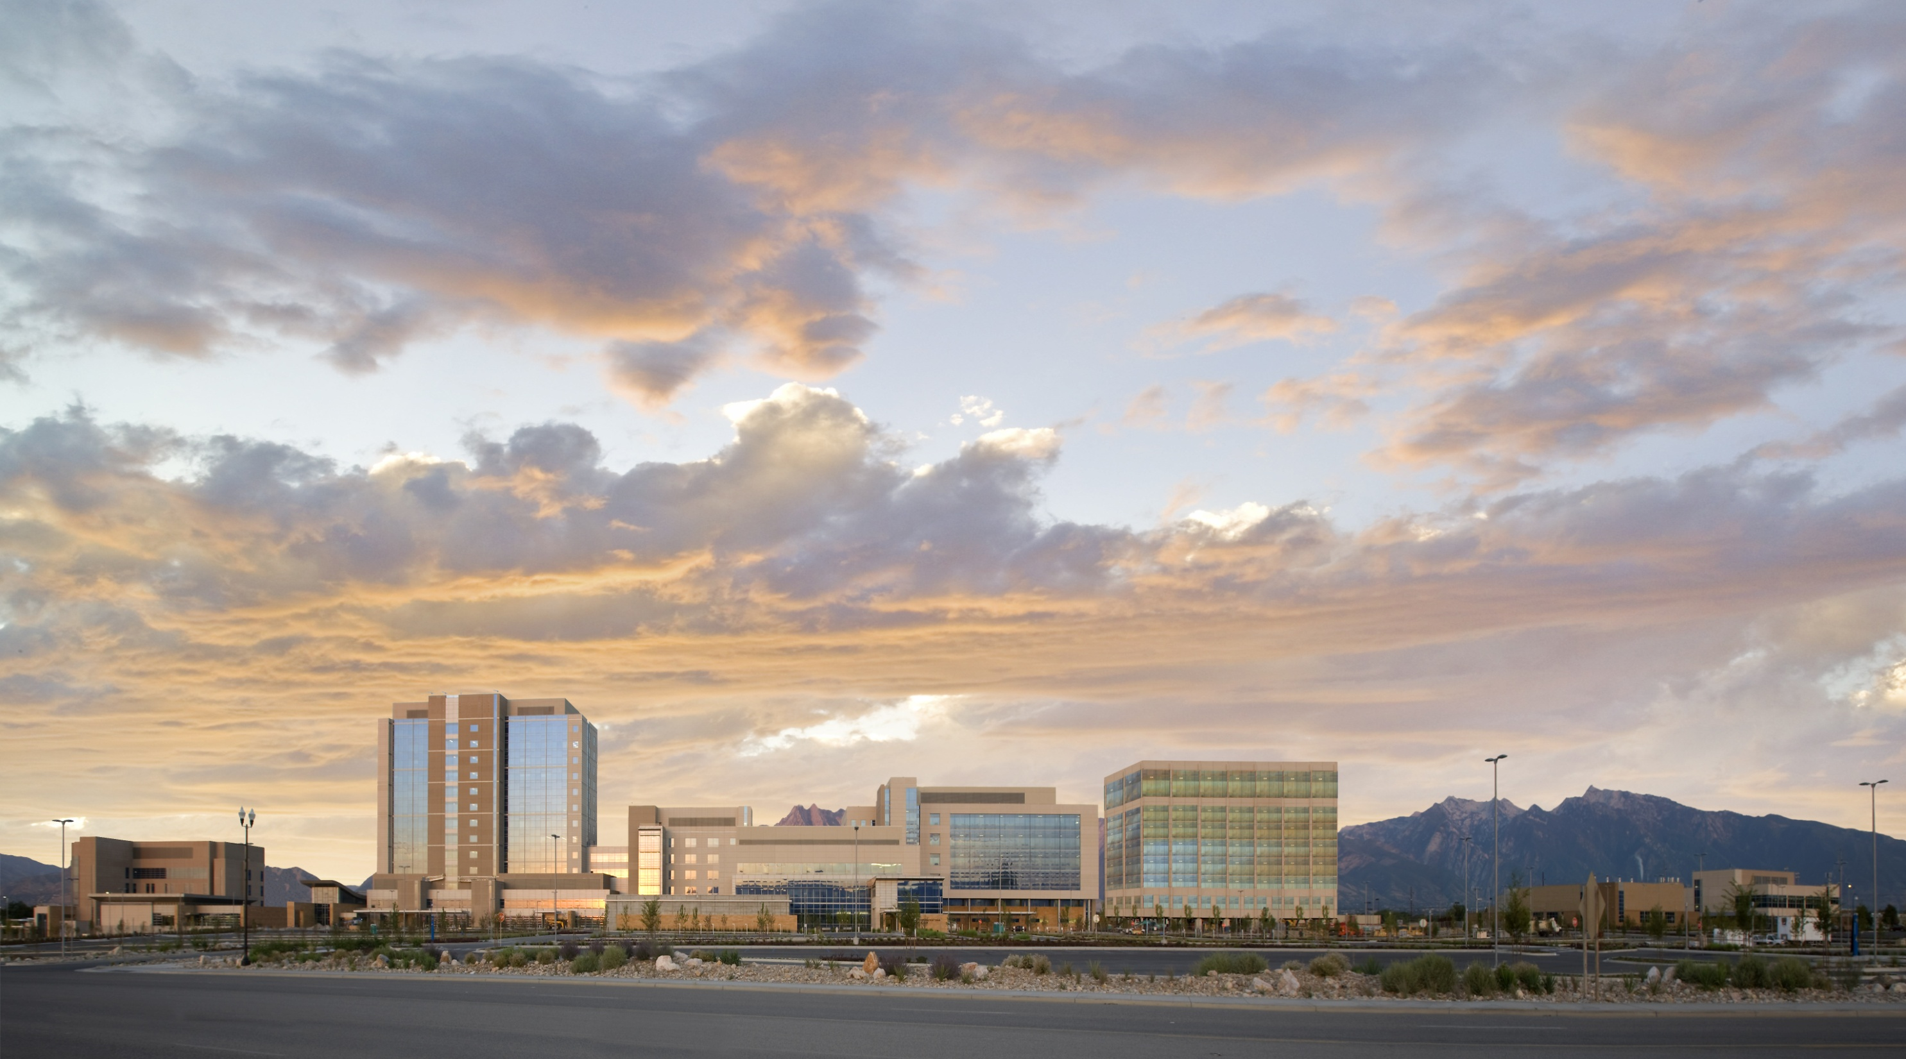
Intermountain Healthcare
Established Founded in 1975 when The Church of Jesus Christ of Latter-day Saints donated its 15-hospital system to the community under Intermountain Healthcare management.
Hospitals 23
Hospital beds 2,802 licensed; 2501 staffed
Clinics 200+
Health Plans insured lives Approximately 750,000
Clinical Programs 8 (Cardiovascular, Oncology, Women & Newborns, Intensive Medicine, Primary Care, Pediatric Specialties, Surgical Services, Behavioral Health)
Employees 38,000 FTE’s
Employee Physicians 1,400+
Affiliated Physicians 5,000

Slide 3
Mission -“Helping people live the healthiest lives possible”
No Harm
Notes:
Liz
This is where we start. Our new mission statement is the foundation for achieving shared accountability, and the LiVe Well Center(s) are Intermountain’s “Center of Excellence” for delivering wellness oriented care to our patients.

Slide 4
A few basics…
Public Transit
Discounted Fares, VanShare, Transit Passes, car pooling
Fleet
Fuel efficient and alternative fuel vehicles, monitoring devices, no idle
Technologies
Web Ex, Tele Presence, Work from Home
Walking & Biking
Safe pathways, lockers, showers

Slide 5
A few Stats…
10.7 million fleet and carpool miles
682 vehicles
All vehicles less than 10 years of age.
Inventory includes, EV, CNG, hybrids, clean diesel, and gasoline
Current UTA Ridership 7%, Total Miles 4,266,782
40 Transit Passes
Work from Home 300+ FTE’s

Slide 6
Goals
Increase Public Transit ridership
Reduce Fleet & Pool miles
Continue to move towards more efficient and alternative fuel vehicles
Increase “Work from Home” FTE’s
Education and Training
Increase Web Ex and Tele Presence
Increase EV charging stations

Slide 7
Actions on “Yellow” Alert Days
Send communication to all employees of “yellow” status with action tips
Encourage use of Public Transit
Limit travel for meetings – use web ex / Tele Presence
Limit projects that use gasoline equipment or vehicles
Allow “Work from Home”

Slide 8
Actions on “Red” Alert Days
Send communication to all employees regarding “Red” status with action tips
Strongly encourage use of public transit
Postpone events and meetings if possible – use web ex or Tele Presence for meetings that cannot be re-scheduled or cancelled
Allow “Work from Home”
Curtail or delay projects that use gasoline fueled equipment / vehicles

Slide 9
Questions
Steven.Bergstrom@imail.org

